Slide 1
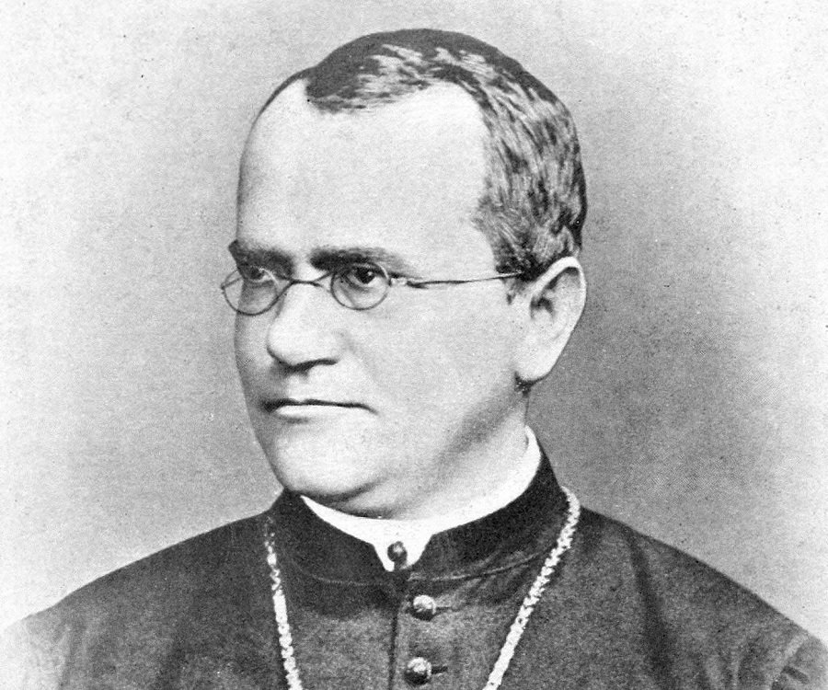

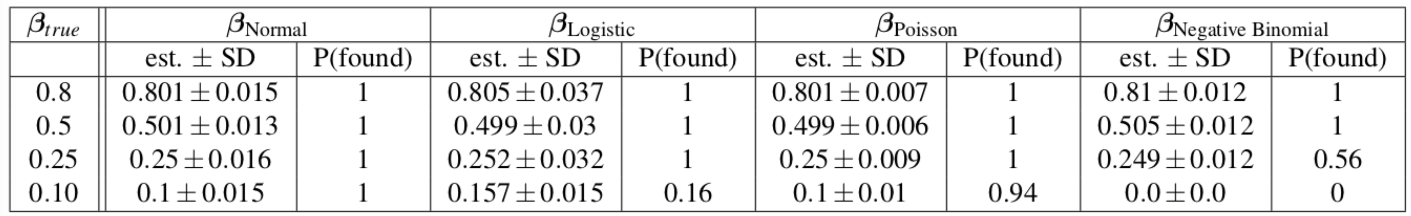
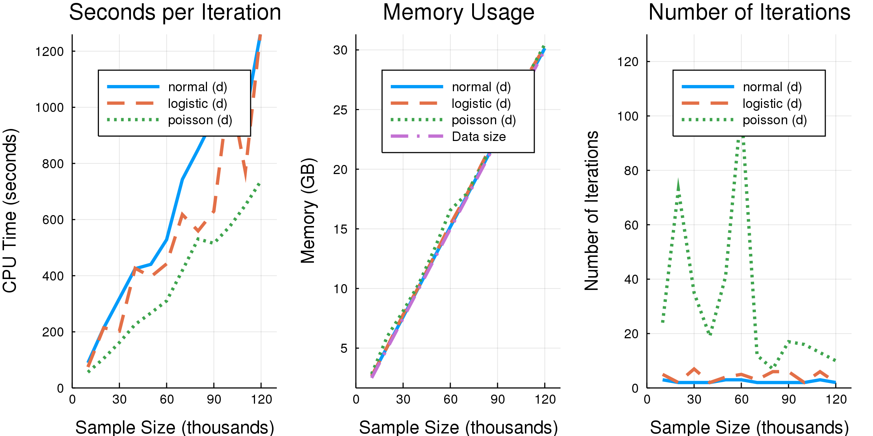
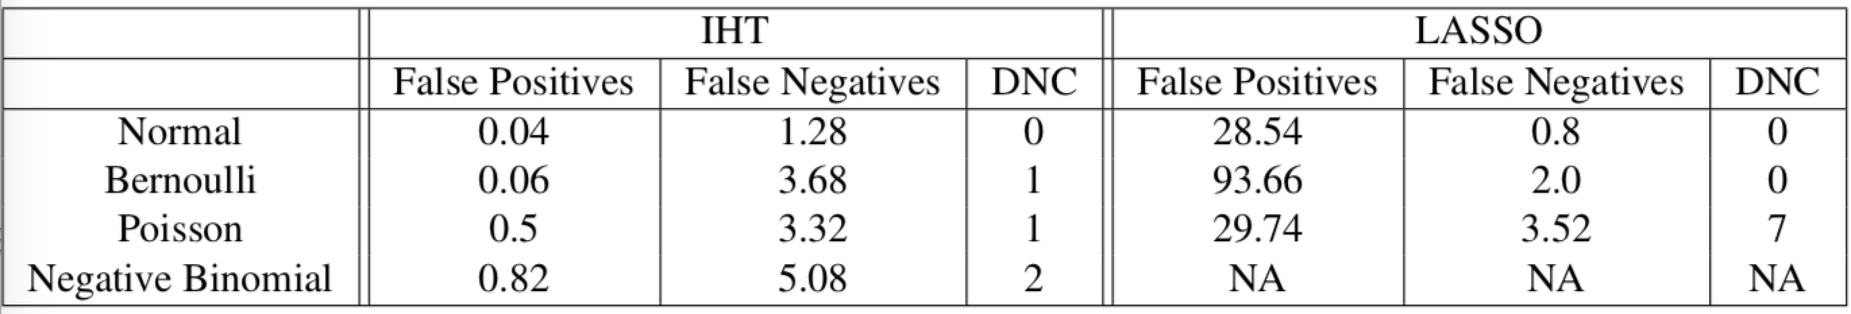
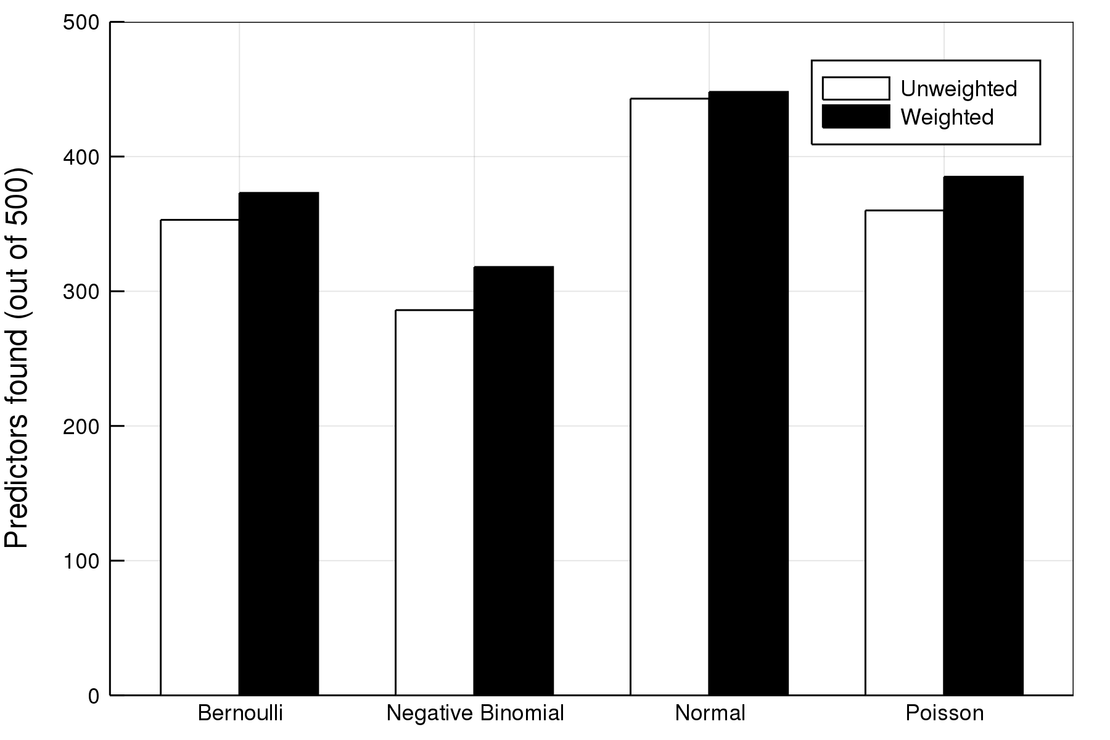
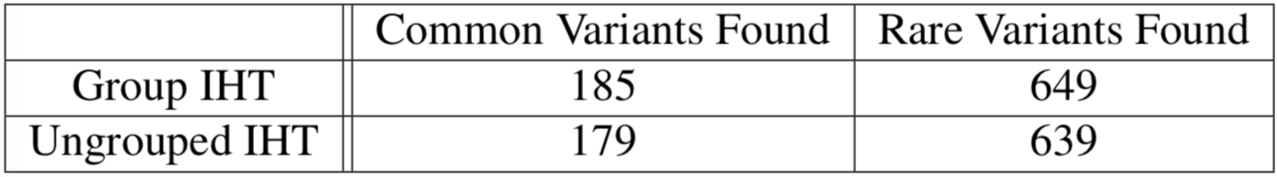
Iterative Hard Thresholding in GWAS: Generalized Linear Models, Prior Weights, and Double Sparsity Benjamin B. Chu¹, Kevin L. Keys², Janet Sinsheimer¹, Kenneth Lange¹ ¹Department of Biomathematics, University of California, Los Angeles ²Department of Medicine, University of California, San Francisco
INTRODUCTION
METHODS
GWASes (genome wide association studies) tries to find SNPs (single nucleotide polymorphisms) associated with a human trait.
SNP-by-SNP association tests ignore joint effects of SNPs BAD BIOLOGY ASSUMPTION
LASSO is a multivariate method that exhibits shrinkage and admits too many false positives BAD STATISTICS FOR GWAS
Fill the gap with new algorithm: Iterative Hard Thresholding (IHT)
Project culminates in MendelIHT.jl a scalable and open sourced package in Julia. Code Repository: https://github.com/biona001/MendelIHT.jl/tree/develop
Problem: Given SNP matrix , trait vector , find a
statistical model such that . Then do it for non-linear case .
Setup: Let be the loglikelihood, the gradient (score), and the expected information matrix. Solve the following:
Algorithm: In loglikelihood space, move in the positive score direction multiplied by a step length to increase along the ray prior to projection :
is a hard thresholding operator that projects a point to some sparsity set with
at most active “groups” and active predictors per group.
RESULTS
Reconstruction Quality for GWAS data:
Testing Scalability (on 1,000,000 SNPs)
Table 1. Normal, Poisson, and Negative Binomial reconstruction results are unbiased, but logistic results may over-estimates small effect sizes. SD represents sample standard deviation of the found predictors, and P(found) indicates the proportion found. Here we ran 100 simulations using n = 5000 samples and p = 100,000 SNPs.
Comparing False Positives/Negatives with LASSO
Table 2. Fifty independent cross validation studies for each response type shows IHT is superior in limiting the number of false positives. Here we used 1000 samples each with 10,000 SNPs. The number of false positives/negatives are averaged over 50 runs, and DNC counts the number of runs that did not converge.
Figure 2. Time per iteration and memory usage scales linearly with data size. Figure shown is running IHT with debiasing (d). The largest problem should fit into a regular desktop computer with 32GB of RAM. Every run is performed on a intel-E5-2670 machine with 63G of RAM and a single 3.3GHz processor.
Weighted IHT
CONCLUSION
Figure 1. Comparison of unweighting and weighting shows weighting can find around 10% more predictors. Here we assumed approximately 1/10 of all SNPs are within a protein coding region, including the 10 true predictors, while others are within introns. We assigned w = 2.0 to all SNPs within coding regions and w = 1.0 for all other SNPs.
IHT provides a principled way for variable selection and estimating precise coefficient
For GWAS, IHT is much better than LASSO at controlling false positive rates
Our implementation of IHT is scalable to the largest dataset today (e.g. UK Biobank)
Table 3: Comparison of doubly sparse group IHT with non-grouped IHT model selection in a case-control studies. Here there are a total of 250 common variants (maf = 0.4) and 1250 rare variants (maf = 0.005).
ACKNOWLEDGEMENTS
Group IHT
This research issupported by NIH Training Grant in Genomic Analysis and Interpretation T32HG002536
This research issupported by Google Summer of Code 2018 with
NumFOCUS and the Julia cohort.

